Slide 1
CDI Resolución de Ejercicios

Slide 2
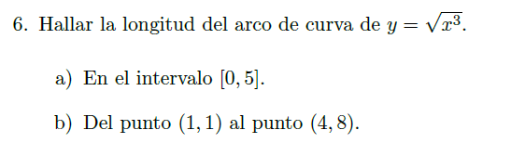

Slide 3


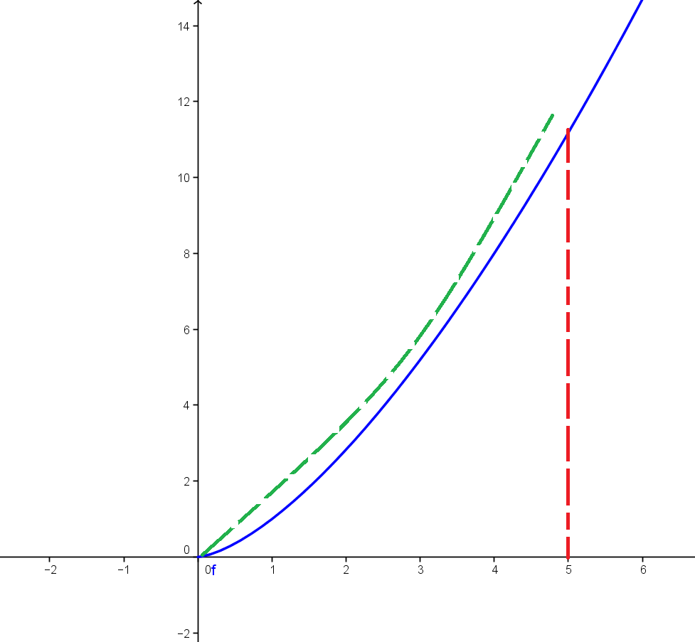






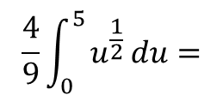
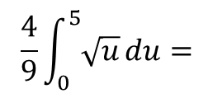
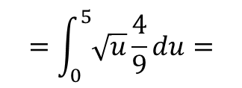
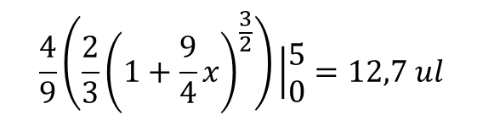
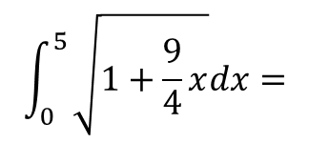
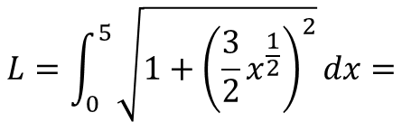
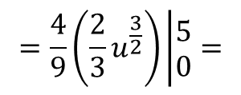
Grafico
$$L=\int_{0}^{5}{\sqrt{1+{\left(\frac{3}{2}x^{\frac{1}{2}}\right)}^{2}}dx}=$$
$$\int_{0}^{5}{\sqrt{1+\frac{9}{4}x}dx}=$$
$$=\int_{0}^{5}{\sqrt{u}}\frac{4}{9}du=$$
$$\frac{4}{9}\int_{0}^{5}{\sqrt{u}}du=$$
$$\frac{4}{9}\int_{0}^{5}{u^{\frac{1}{2}}}du=$$
Sustitución
$$\frac{4}{9}\left(\frac{2}{3}{\left(1+\frac{9}{4}x\right)}^{\frac{3}{2}}\right)\left|\begin{matrix}5 \\ 0\end{matrix}\right.=12,7 ul$$
$$=\frac{4}{9}\left(\frac{2}{3}u^{\frac{3}{2}}\right)\left|\begin{matrix}5 \\ 0\end{matrix}\right.=$$

Slide 4
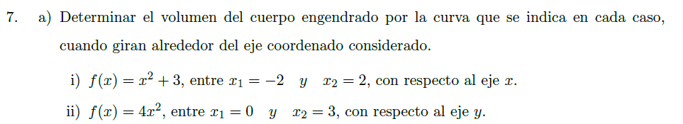

Slide 5


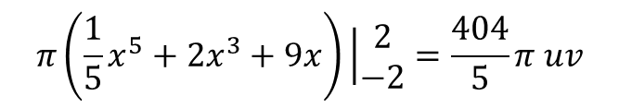
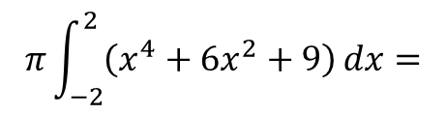
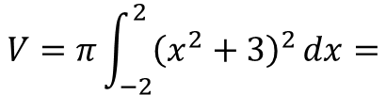
Volumen
$$V=π\int_{−2}^{2}{{\left(x^{2}+3\right)}^{2}}dx=$$
$$π\int_{−2}^{2}{\left(x^{4}+6x^{2}+9\right)}dx=$$
$$π\left(\frac{1}{5}x^{5}+2x^{3}+9x\right)\left|\begin{matrix}2 \\ −2\end{matrix}\right.=\frac{404}{5}π uv$$

Slide 6


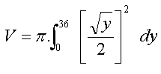






Volumen
Determinación de g(y)
Determinación de c y d

Slide 7



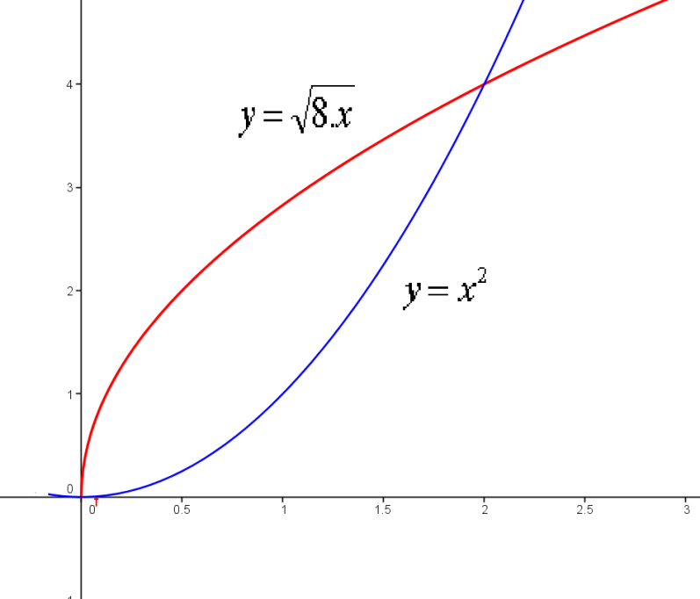

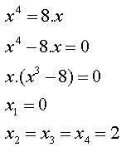
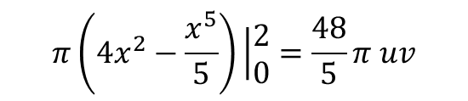
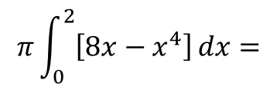
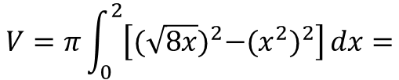
Grafico
Extremos
Volumen
$$V=π\int_{0}^{2}{\left[{(\sqrt{8x})}^{2}−{(x^{2})}^{2}\right]}dx=$$
$$π\int_{0}^{2}{\left[8x−x^{4}\right]}dx=$$
$$π\left(4x^{2}−\frac{x^{5}}{5}\right)\left|\begin{matrix}2 \\ 0\end{matrix}\right.=\frac{48}{5}π uv$$

Slide 8
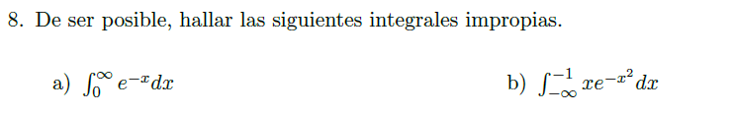


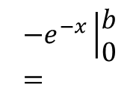
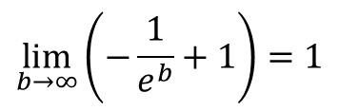
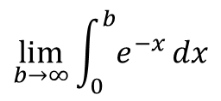

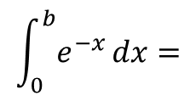
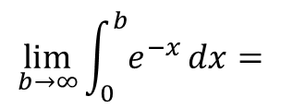
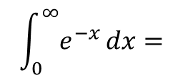
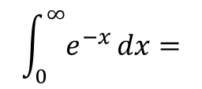
$$\int_{0}^{∞}{e^{−x}}dx=$$
$$\lim_{b→∞}{\int_{0}^{b}{e^{−x}}}dx$$
Determinamos la integral
$$\int_{0}^{b}{e^{−x}}dx=$$
$${−e}^{−x}\left|\begin{matrix}b \\ 0\end{matrix}\right.=$$
$${−e}^{−b}−\left(−e^{0}\right)={−e}^{−b}+1$$
$$\int_{0}^{∞}{e^{−x}}dx=$$
$$\lim_{b→∞}\int_{0}^{b}{e^{−x}}dx=$$
$$\lim_{b→∞}\left(−\frac{1}{e^{b}}+1\right)=1$$
$$\lim_{b→∞}\left({−e}^{−b}+1\right)=$$

Slide 9




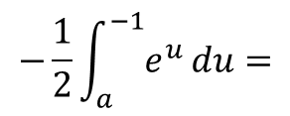
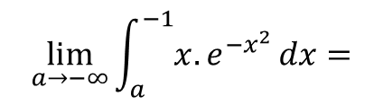
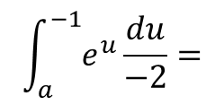
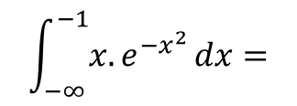
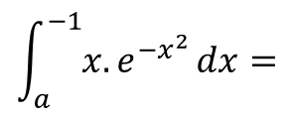
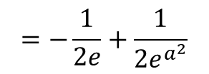
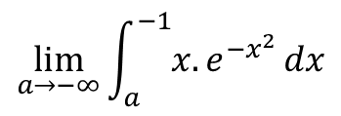
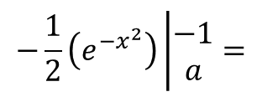
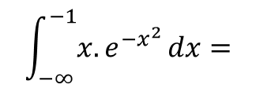
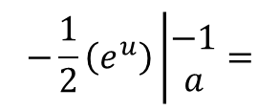
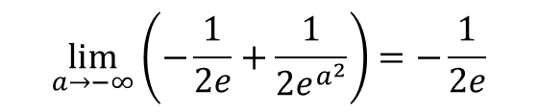
$$\int_{−∞}^{−1}{{x.e}^{{−x}^{2}}}dx=$$
$$\lim_{a→−∞}\int_{a}^{−1}{{x.e}^{{−x}^{2}}}dx$$
Determinamos la integral
$$\int_{a}^{−1}{{x.e}^{{−x}^{2}}}dx=$$
$$\int_{a}^{−1}{e^{u}}\frac{du}{−2}=$$
$$−\frac{1}{2}\int_{a}^{−1}{e^{u}}du=$$
$$−\frac{1}{2}\left(e^{u}\right)\left|\begin{matrix}−1 \\ a\end{matrix}\right.=$$
$$−\frac{1}{2}\left(e^{{−x}^{2}}\right)\left|\begin{matrix}−1 \\ a\end{matrix}\right.=$$
M.S
$$=−\frac{1}{2e}+\frac{1}{2e^{a^{2}}}$$
$$\int_{−∞}^{−1}{{x.e}^{{−x}^{2}}}dx=$$
$$\lim_{a→−∞}{\int_{a}^{−1}{{x.e}^{{−x}^{2}}}}dx=$$
$$\lim_{a→−∞}\left(−\frac{1}{2e}+\frac{1}{2e^{a^{2}}}\right)=−\frac{1}{2e}$$

